Slide 1
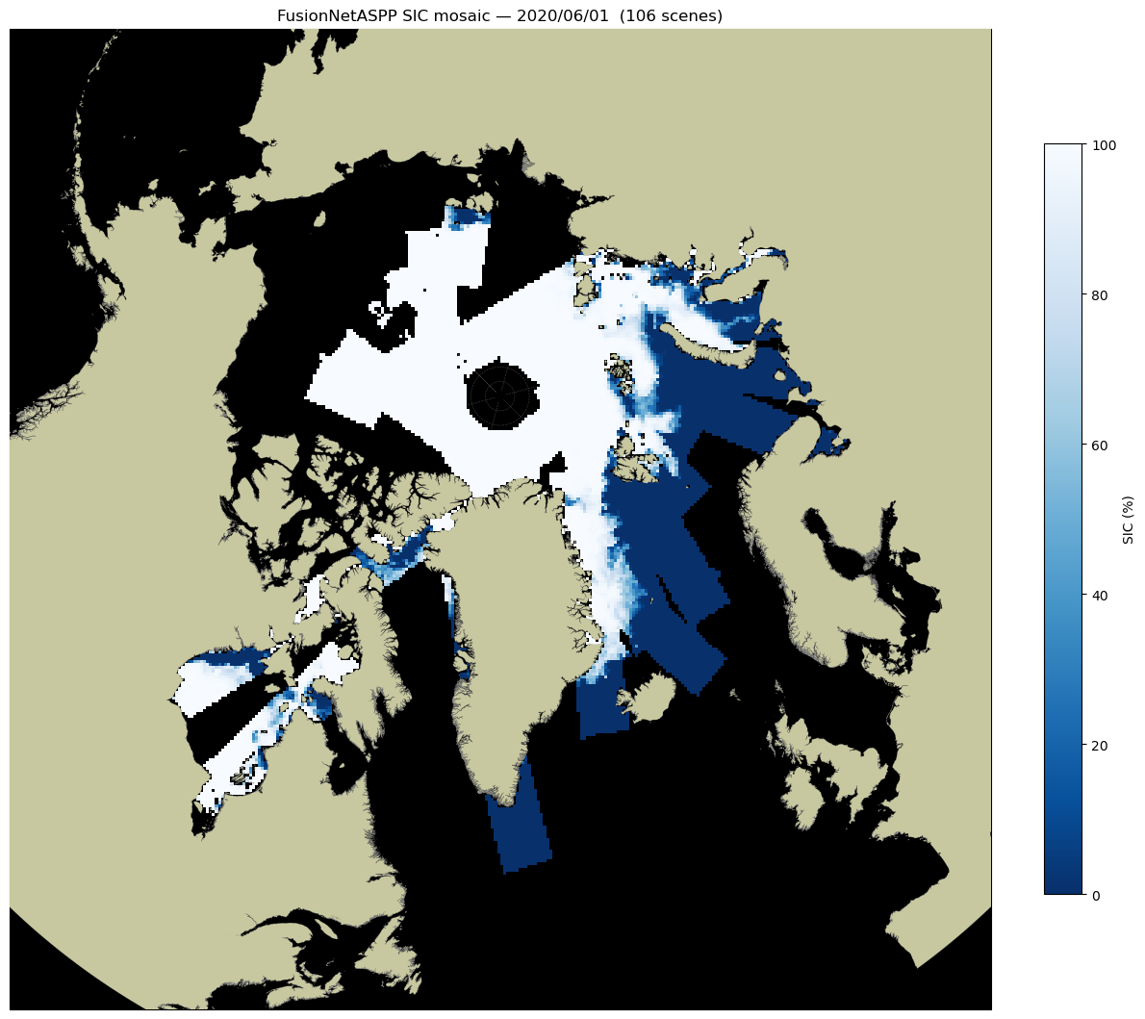

Slide 2
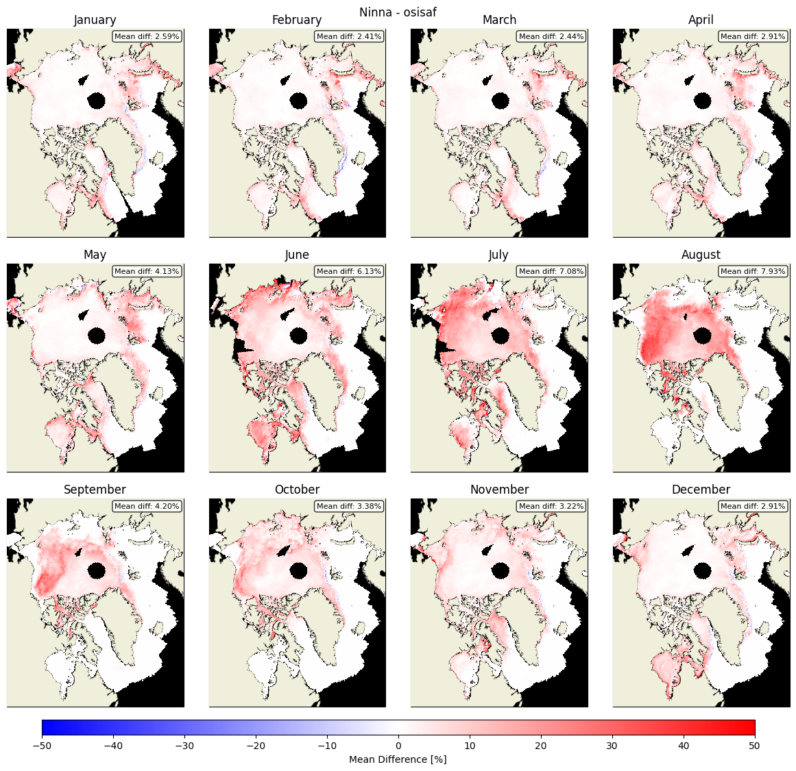

Slide 3
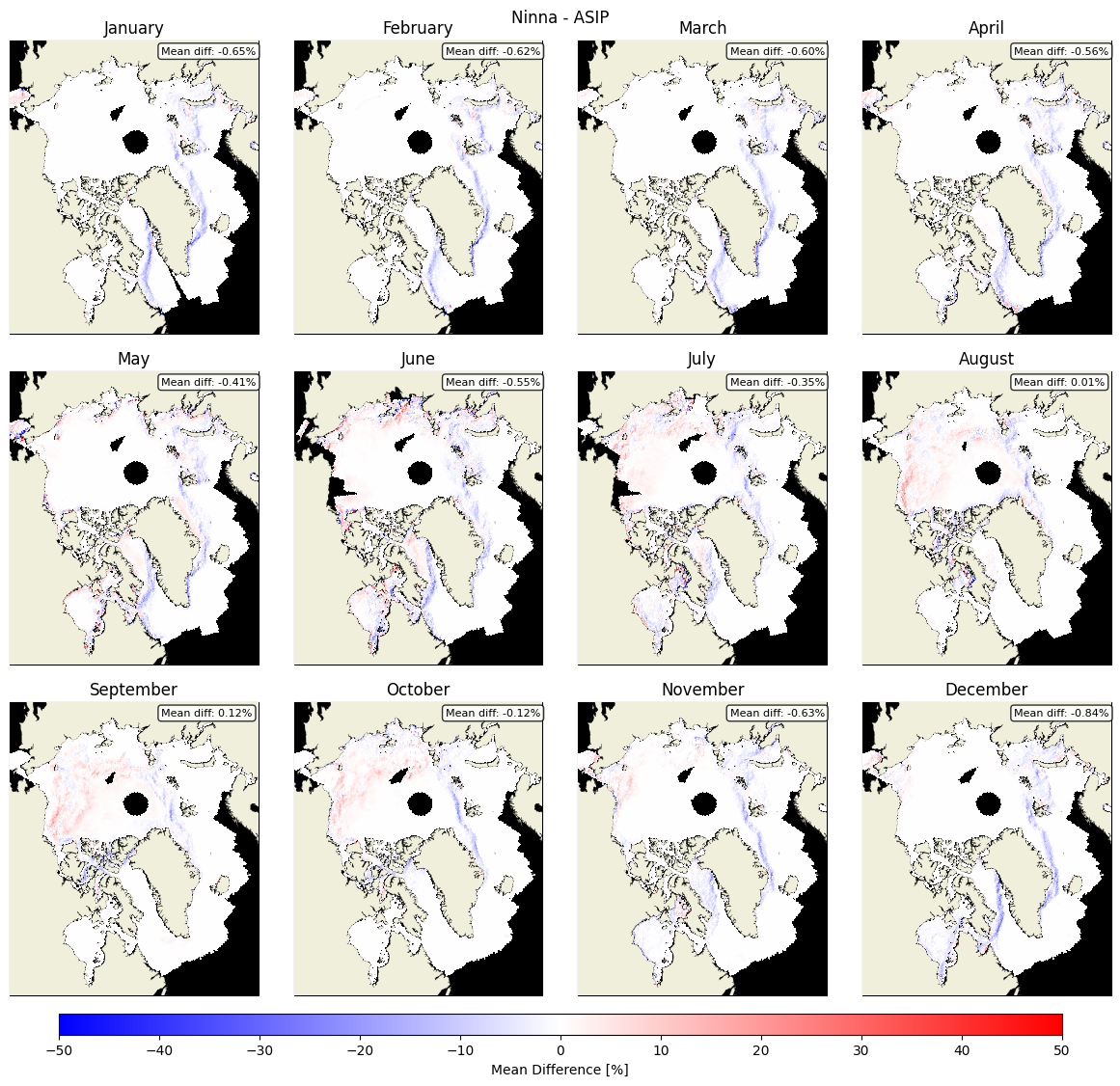

Slide 4
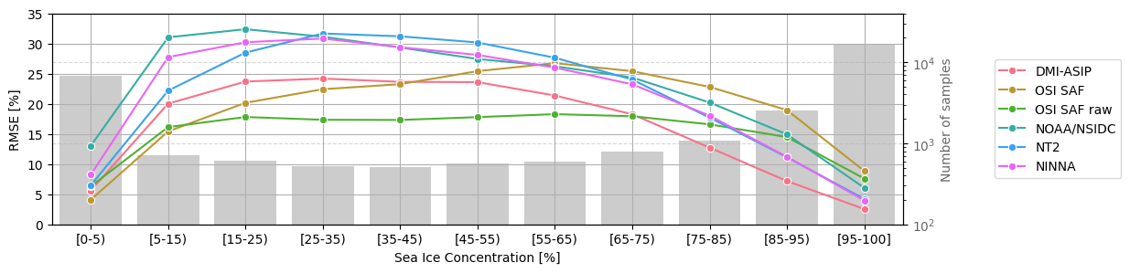
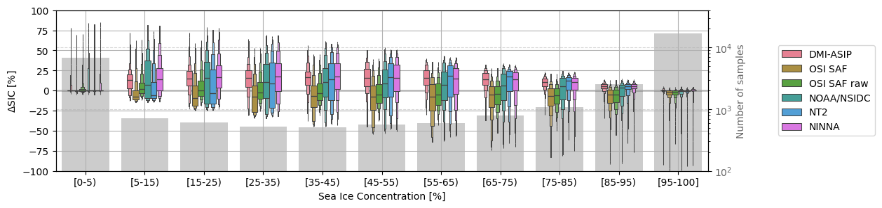

Slide 5
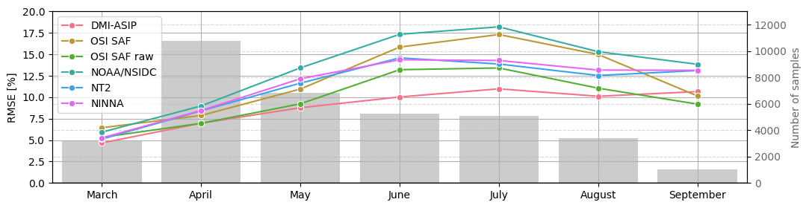
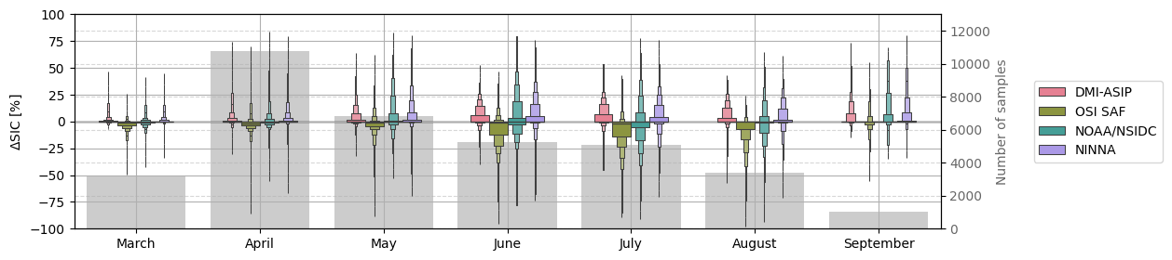

Slide 6
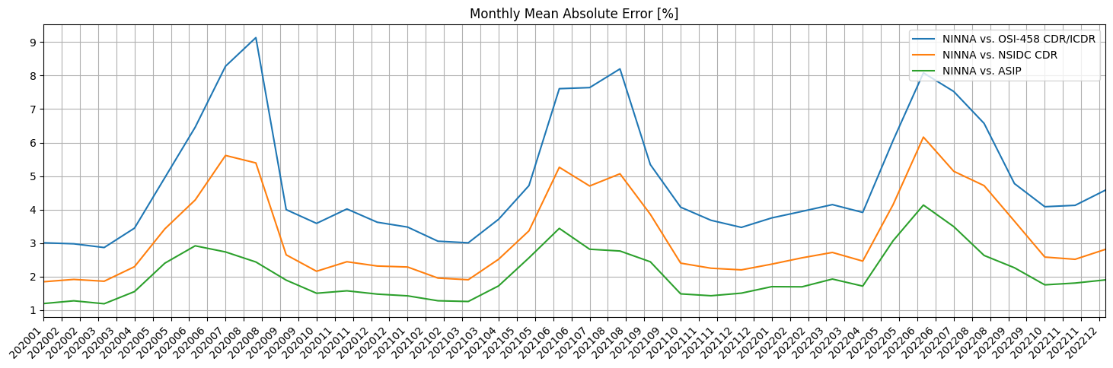

Slide 7
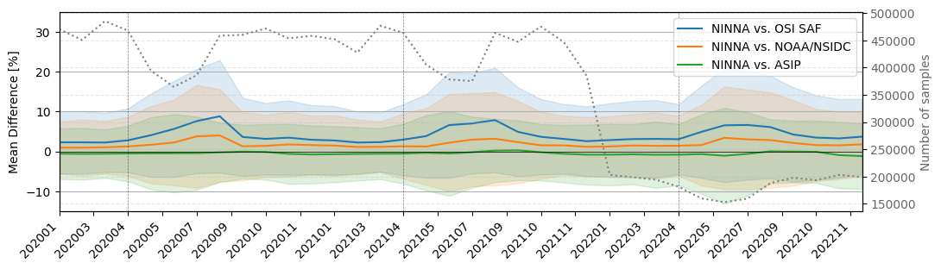

Slide 8
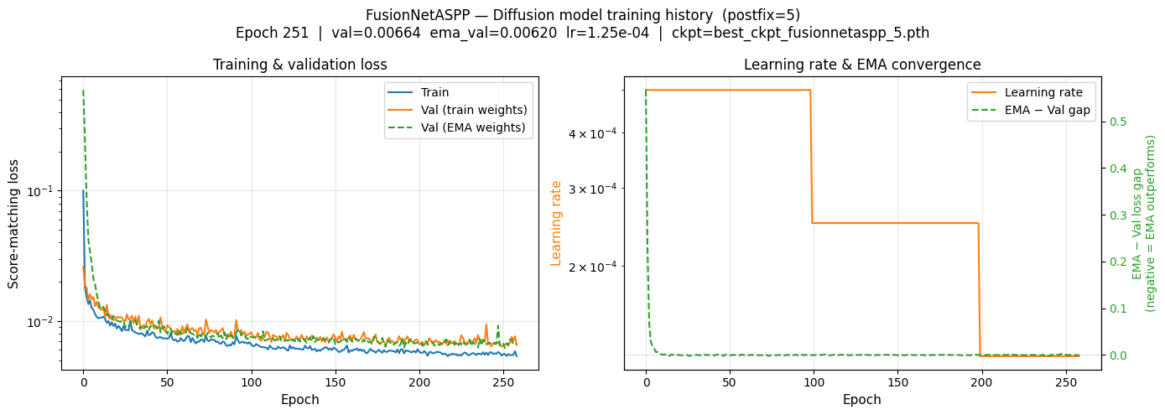

Slide 9
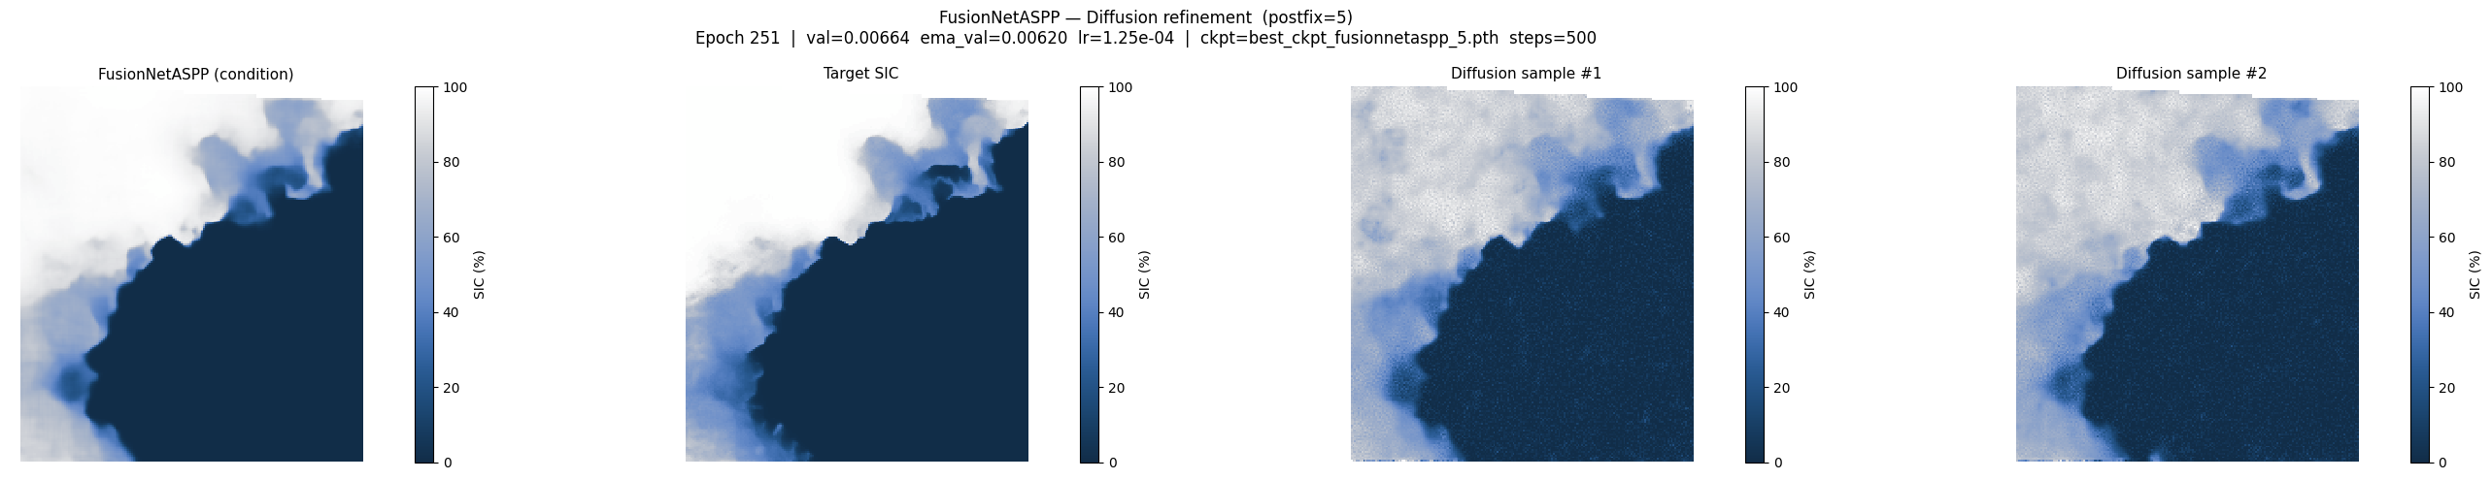

Slide 10
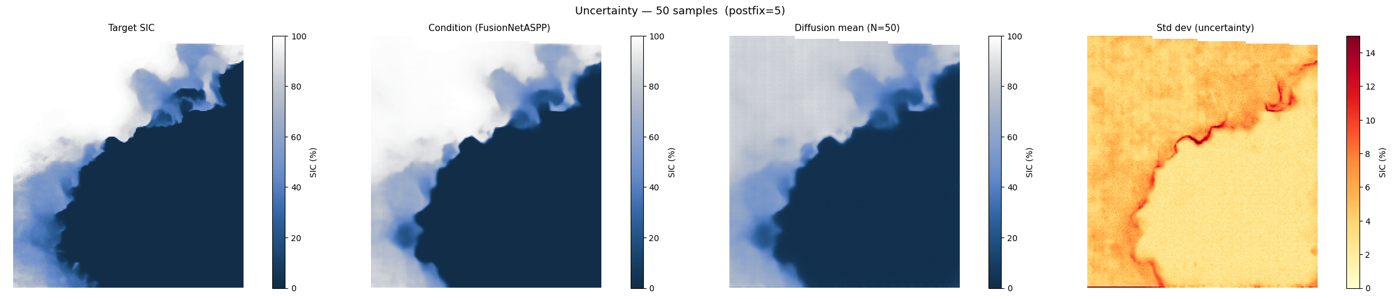

Slide 11
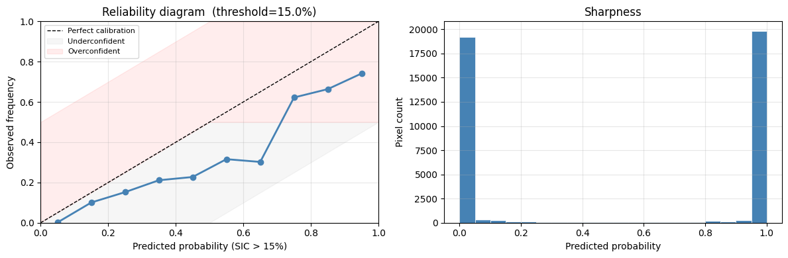
──────────────────────────────────────────
VERIFICATION SCORES
──────────────────────────────────────────
FusionNetASPP MAE : 3.438%
Diffusion mean MAE : 7.432%
Diffusion CRPS : 5.590% (N=50 samples)
CRPS skill score : -62.569%
──────────────────────────────────────────

Slide 12
PASCAL — Passive microwave Arctic Sea ice Concentration ALgorithm
PRISM — Passive micRowave Ice concentration Super-resolution Model
AMIC — AMSR2 Microwave Ice Concentration
SPICE — Super-resolution Passive Ice Concentration Estimator
MICE — Microwave Ice Concentration Estimator
PRIMA — Passive micRowave Ice Mosaic Algorithm
ASPIC — AMSR2 Super-resolution Passive Ice Concentration
MUSIC — Microwave Ultra-resolution Sea Ice Concentration
PRISE — Passive micRowave Ice Super-resolution Estimator
FUSIC — FUsion Super-resolution Ice Concentration
SURF — Super-resolution Using passive micRowave Fusion

